Slide 1



Slide 2


Slide 3
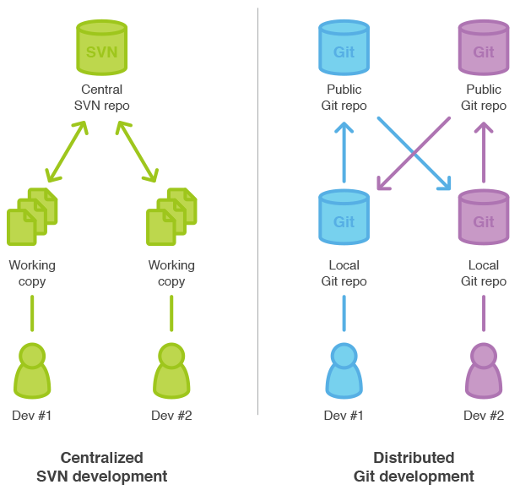

Slide 4

Git flow

Slide 5
Terms
Working directory
Index
Сommit
Branch
Merge
Remote
Push
Pull
HEAD
Tag

Slide 6
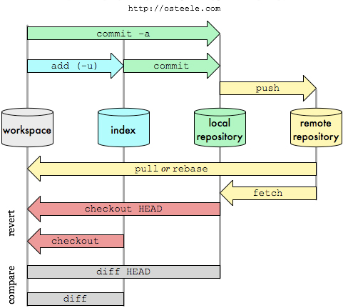
Git Data Transport Commands

Slide 7
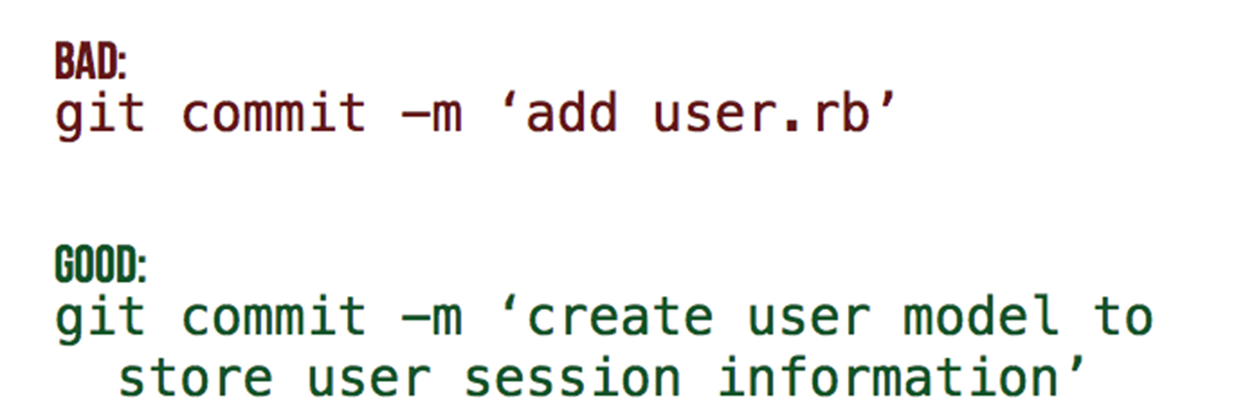
Committing often and
with the right message

Slide 8
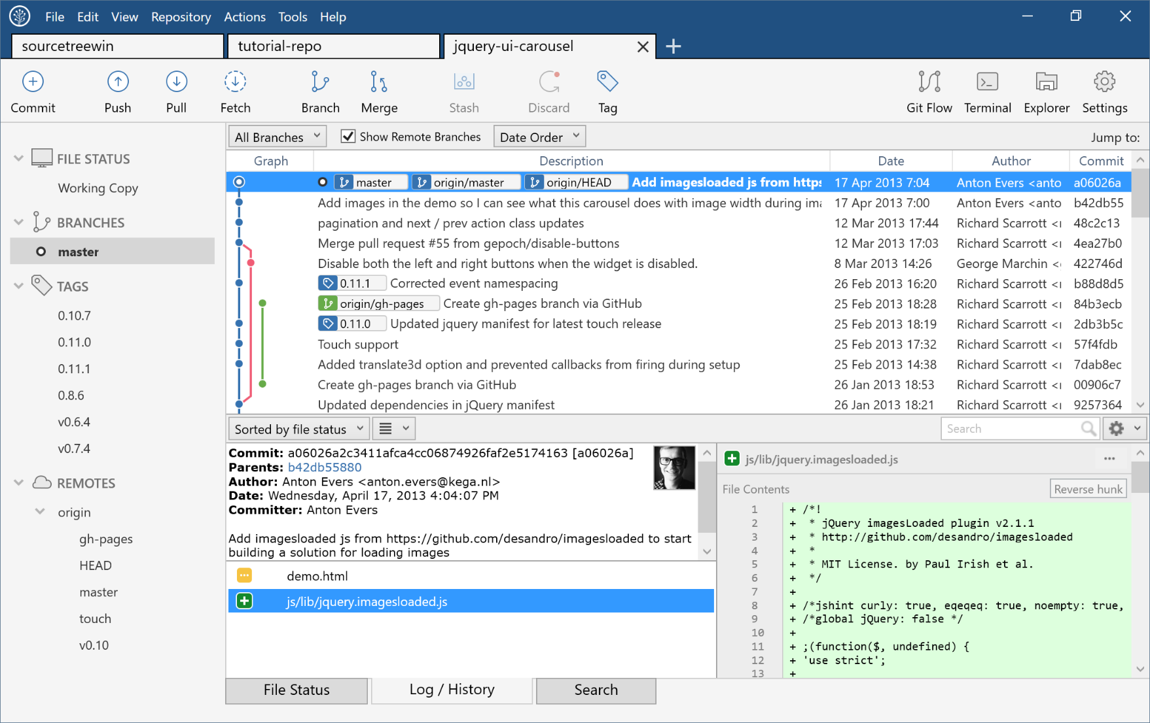
UI
SourceTree
GitKraken etc.

Slide 9

.gitignore
/bin
/obj
/.vs.suo
/packages
...

Slide 10
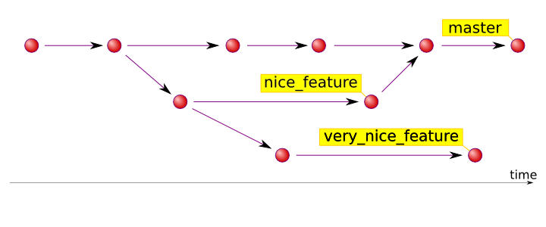
Branches. How to deal with?

Slide 11
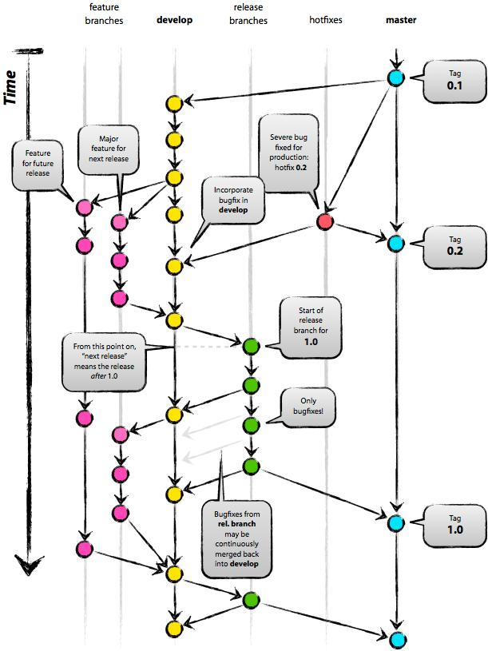
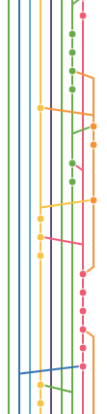

Slide 12

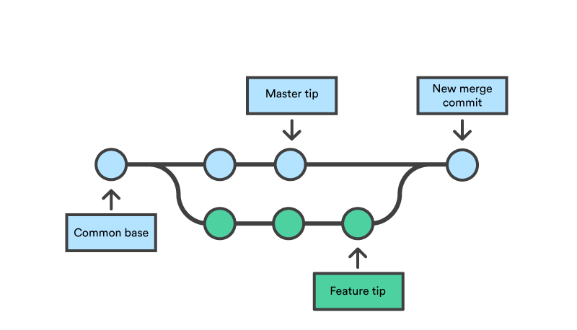
Merge

Slide 13
Trunk-Based Development

Slide 14
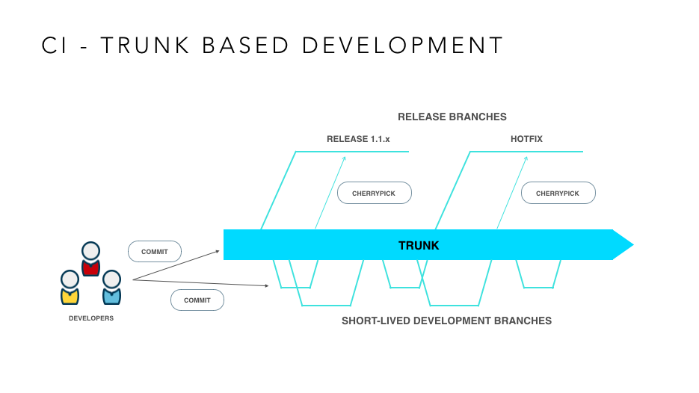

Slide 15


Slide 16

Sources
Git basics http://www.vitaliypodoba.com/2014/06/git-basics/
Git branching model https://habrahabr.ru/post/106912/
Trunk Based Development https://trunkbaseddevelopment.com/

Slide 17
Now I do want to answer your questions

